Slide 1
Breeding Simulation via AlphaSimR
Mao Huang
05-2022

Slide 2
Why Simulation?
A Useful tool
Assist breeders’ decision-marking
Dissecting problems that are difficult to address experimentally
Refine crop management strategies
Evaluate future genetic gains in breeding programs
etc

Slide 3
Use of Simulation
Bentsen and Olesen 2002
Assessing changes of inbreeding rates over time
Gezan et al. 2010
Identify ideal field experimental design to control spatial variation in forestry studies
Lorenz 2013
Simulation guided Decision making between the sizes of population vs number of replications to be tested
Dresboll and Thorup-Kristensen, 2014
Simulate and compare different ways to improve N use efficiency for wheat
Hickey et al. 2014
Compare GS vs PS via simulation, assist breeders allocate genotyping vs phenotyping resources
Muleta et al. 2019
Evaluate potential genetic gains in a young sorghum breeding program

Slide 4
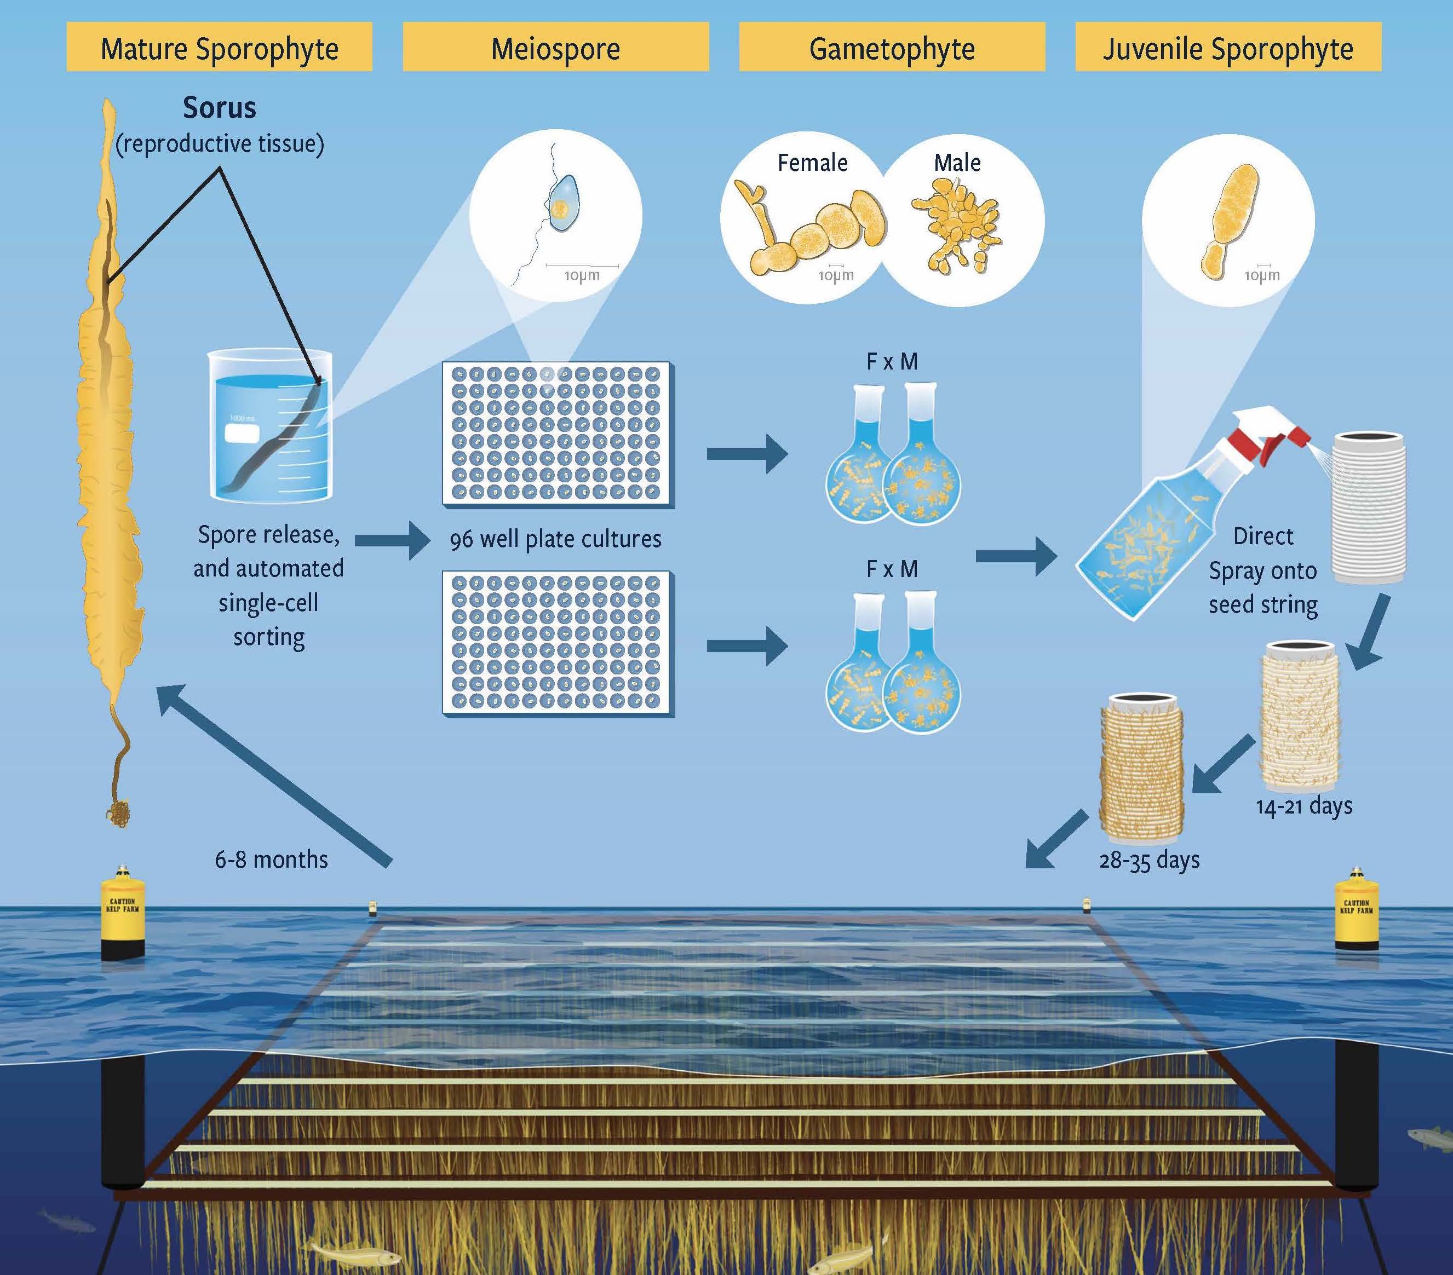
Sugar kelp (Saccharina latissima) breeding simulation and results
SP
GP
SP

Slide 5
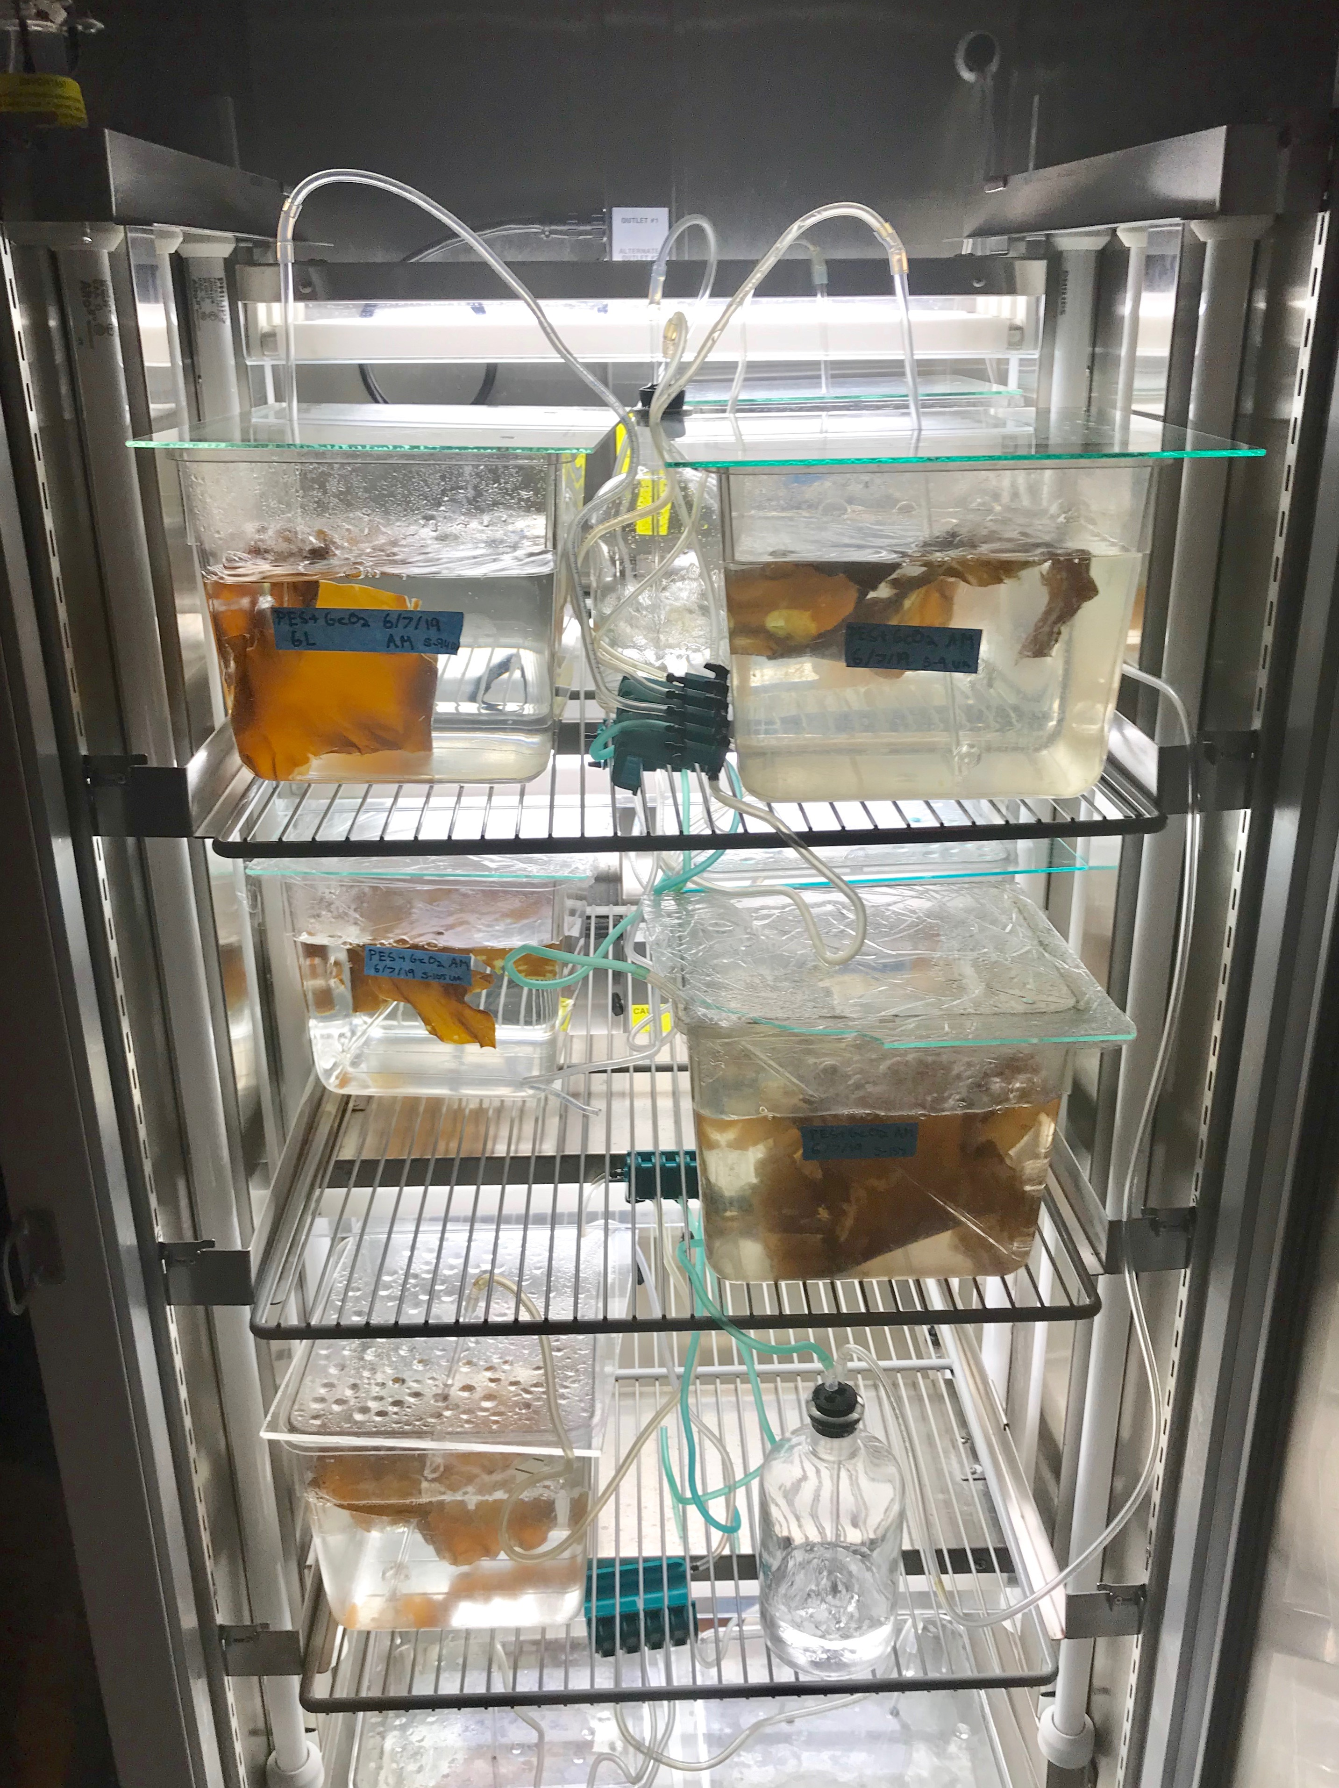
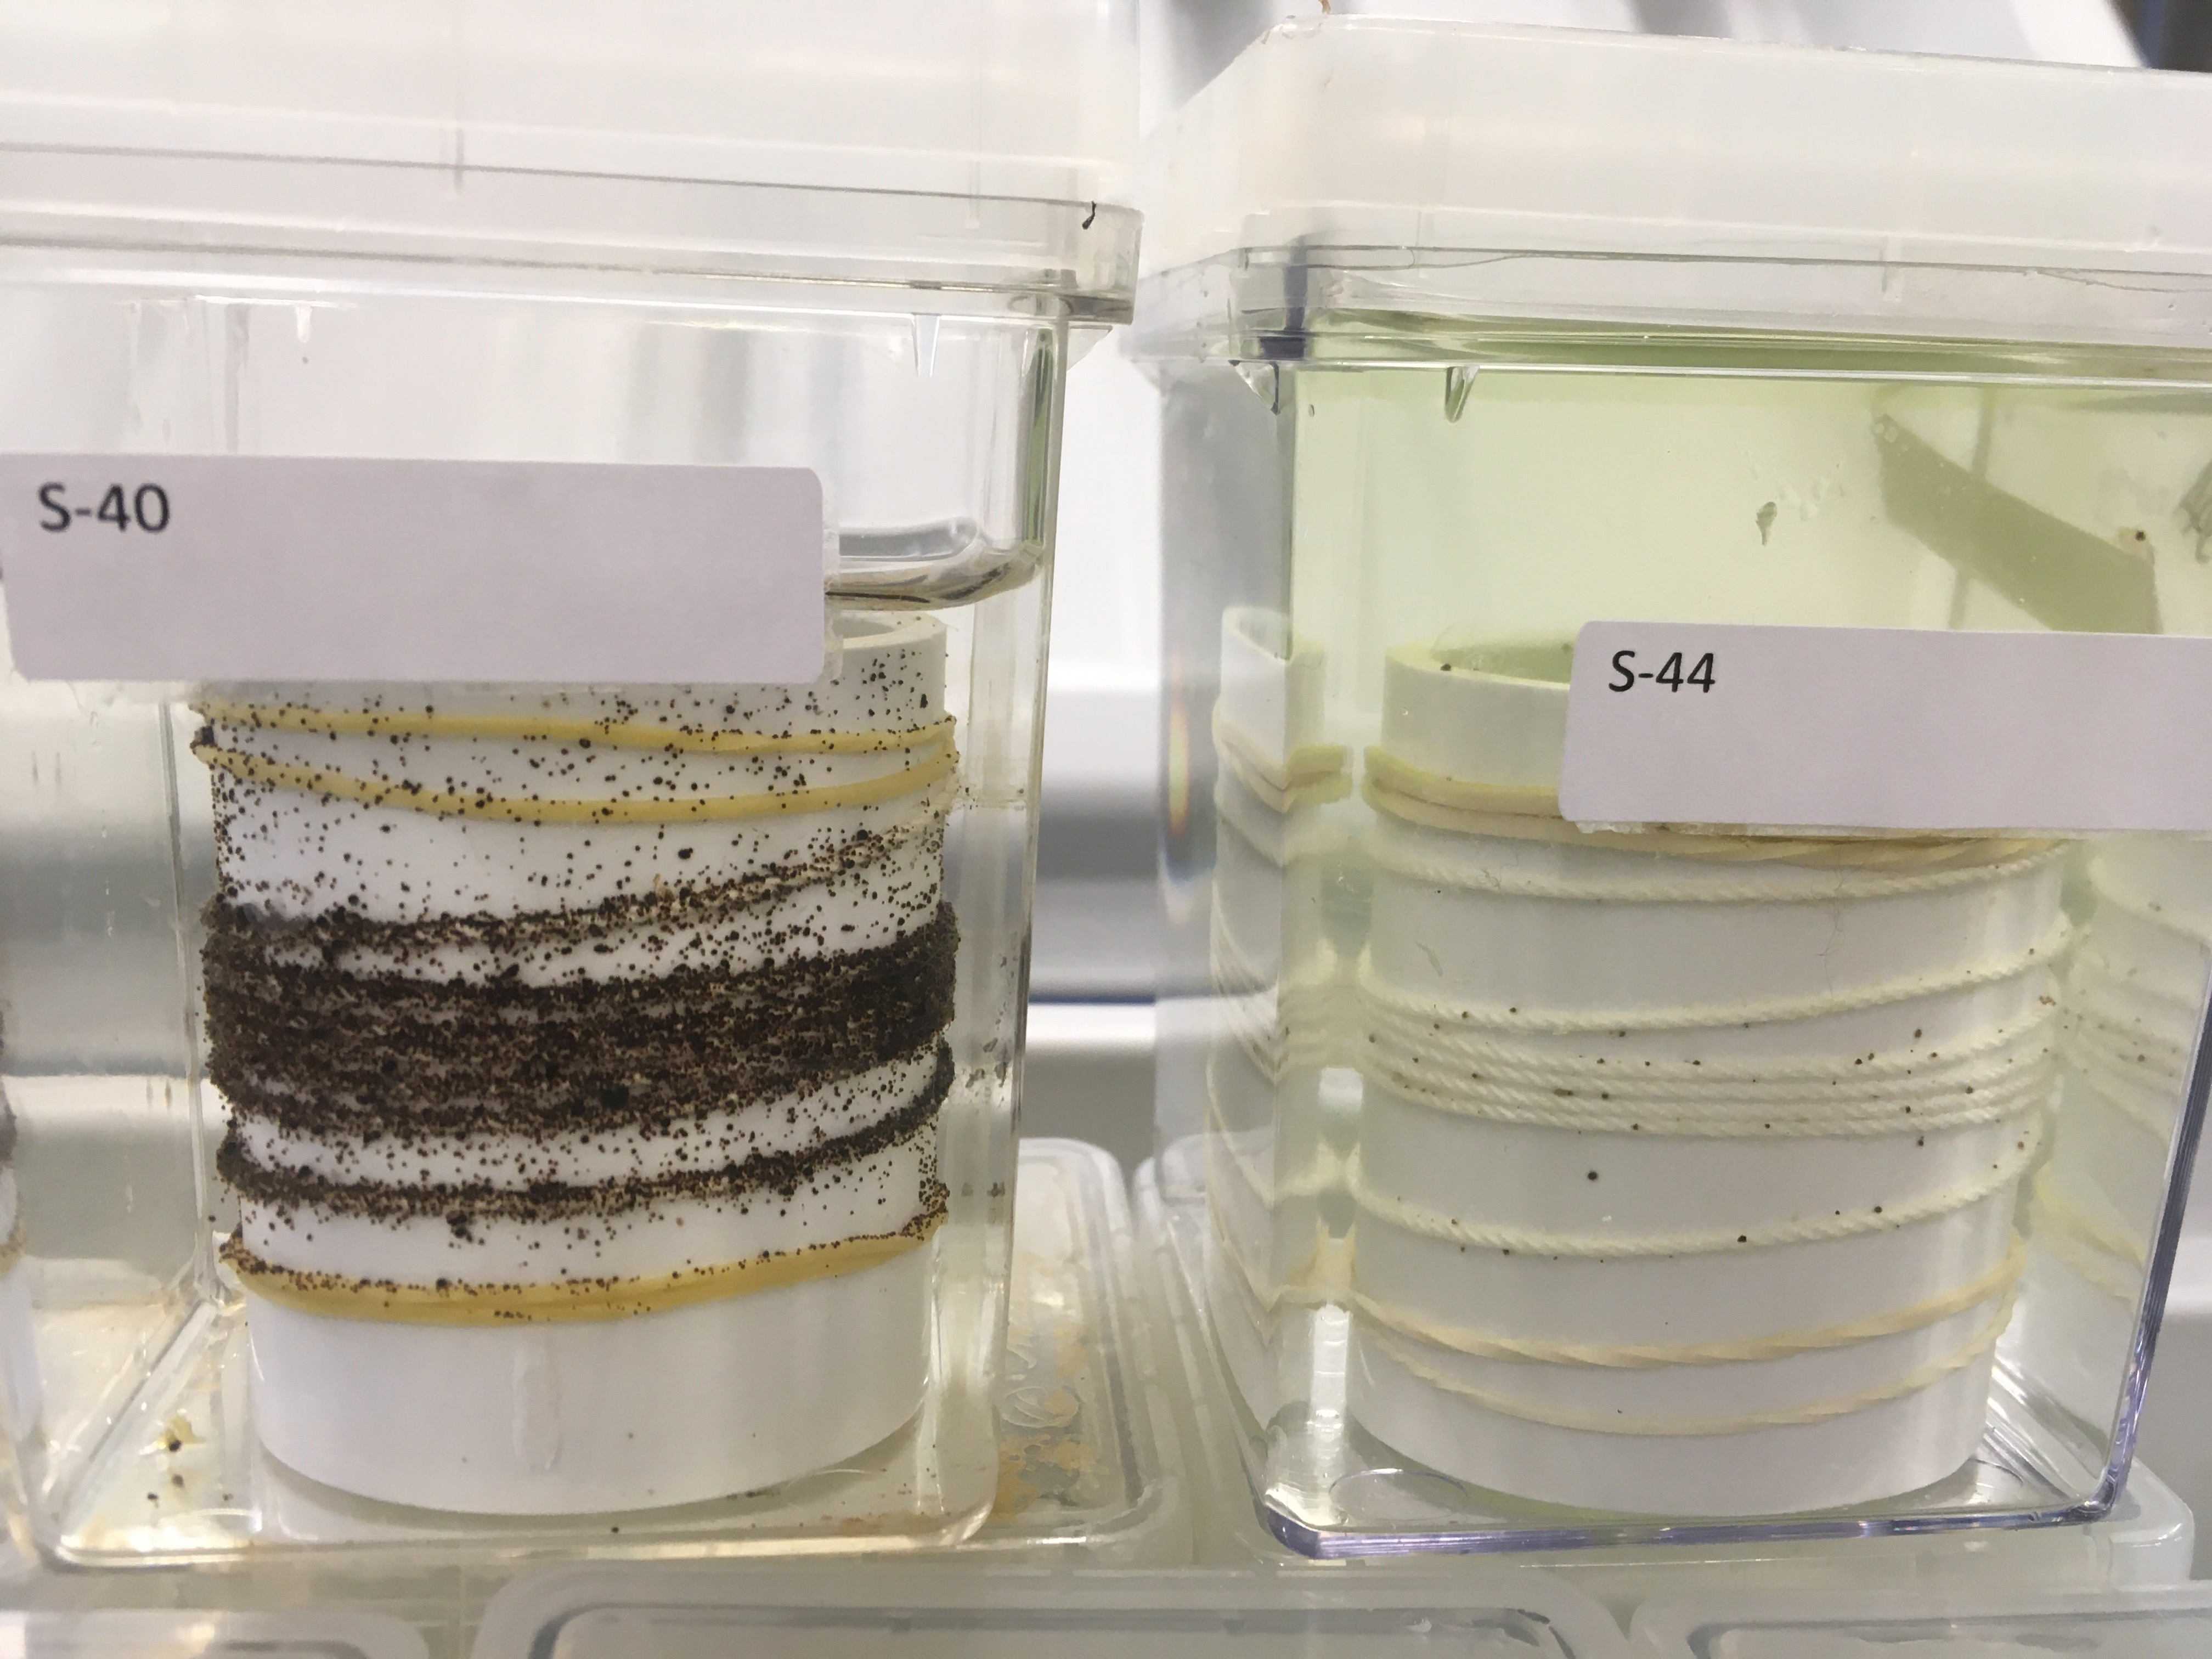
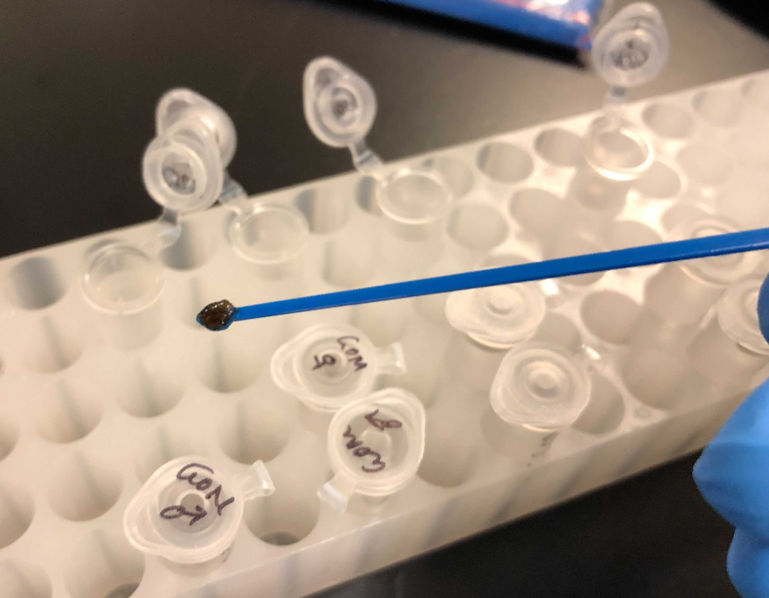
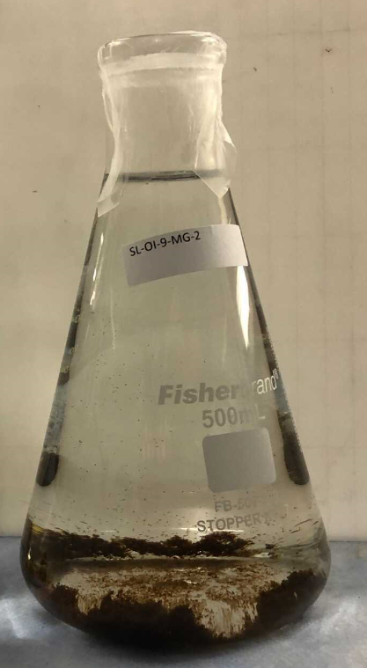
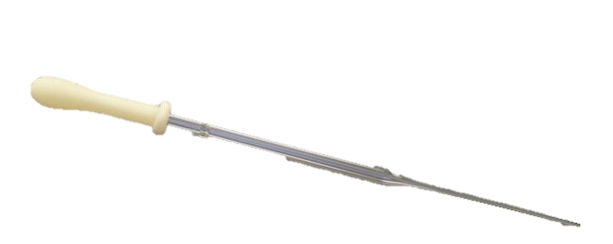
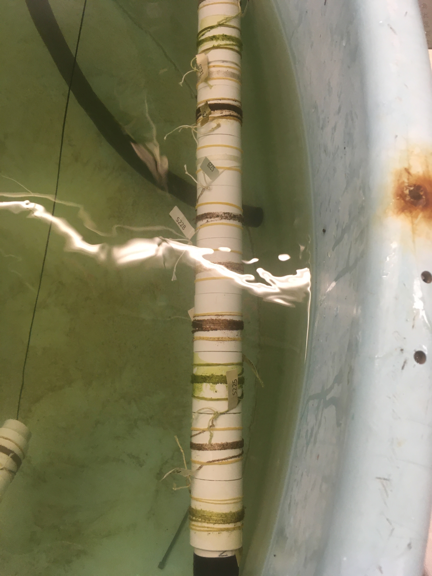
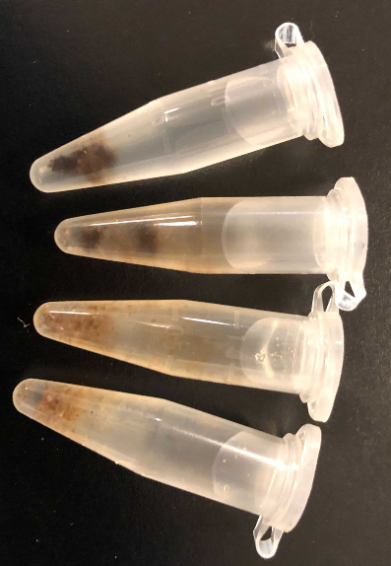
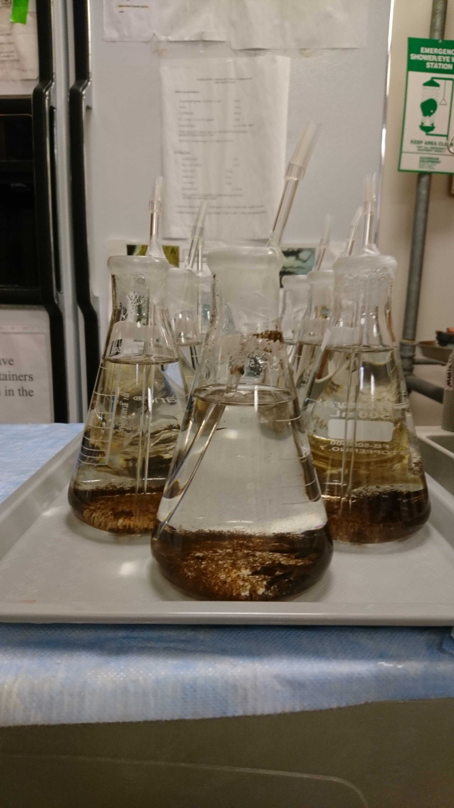
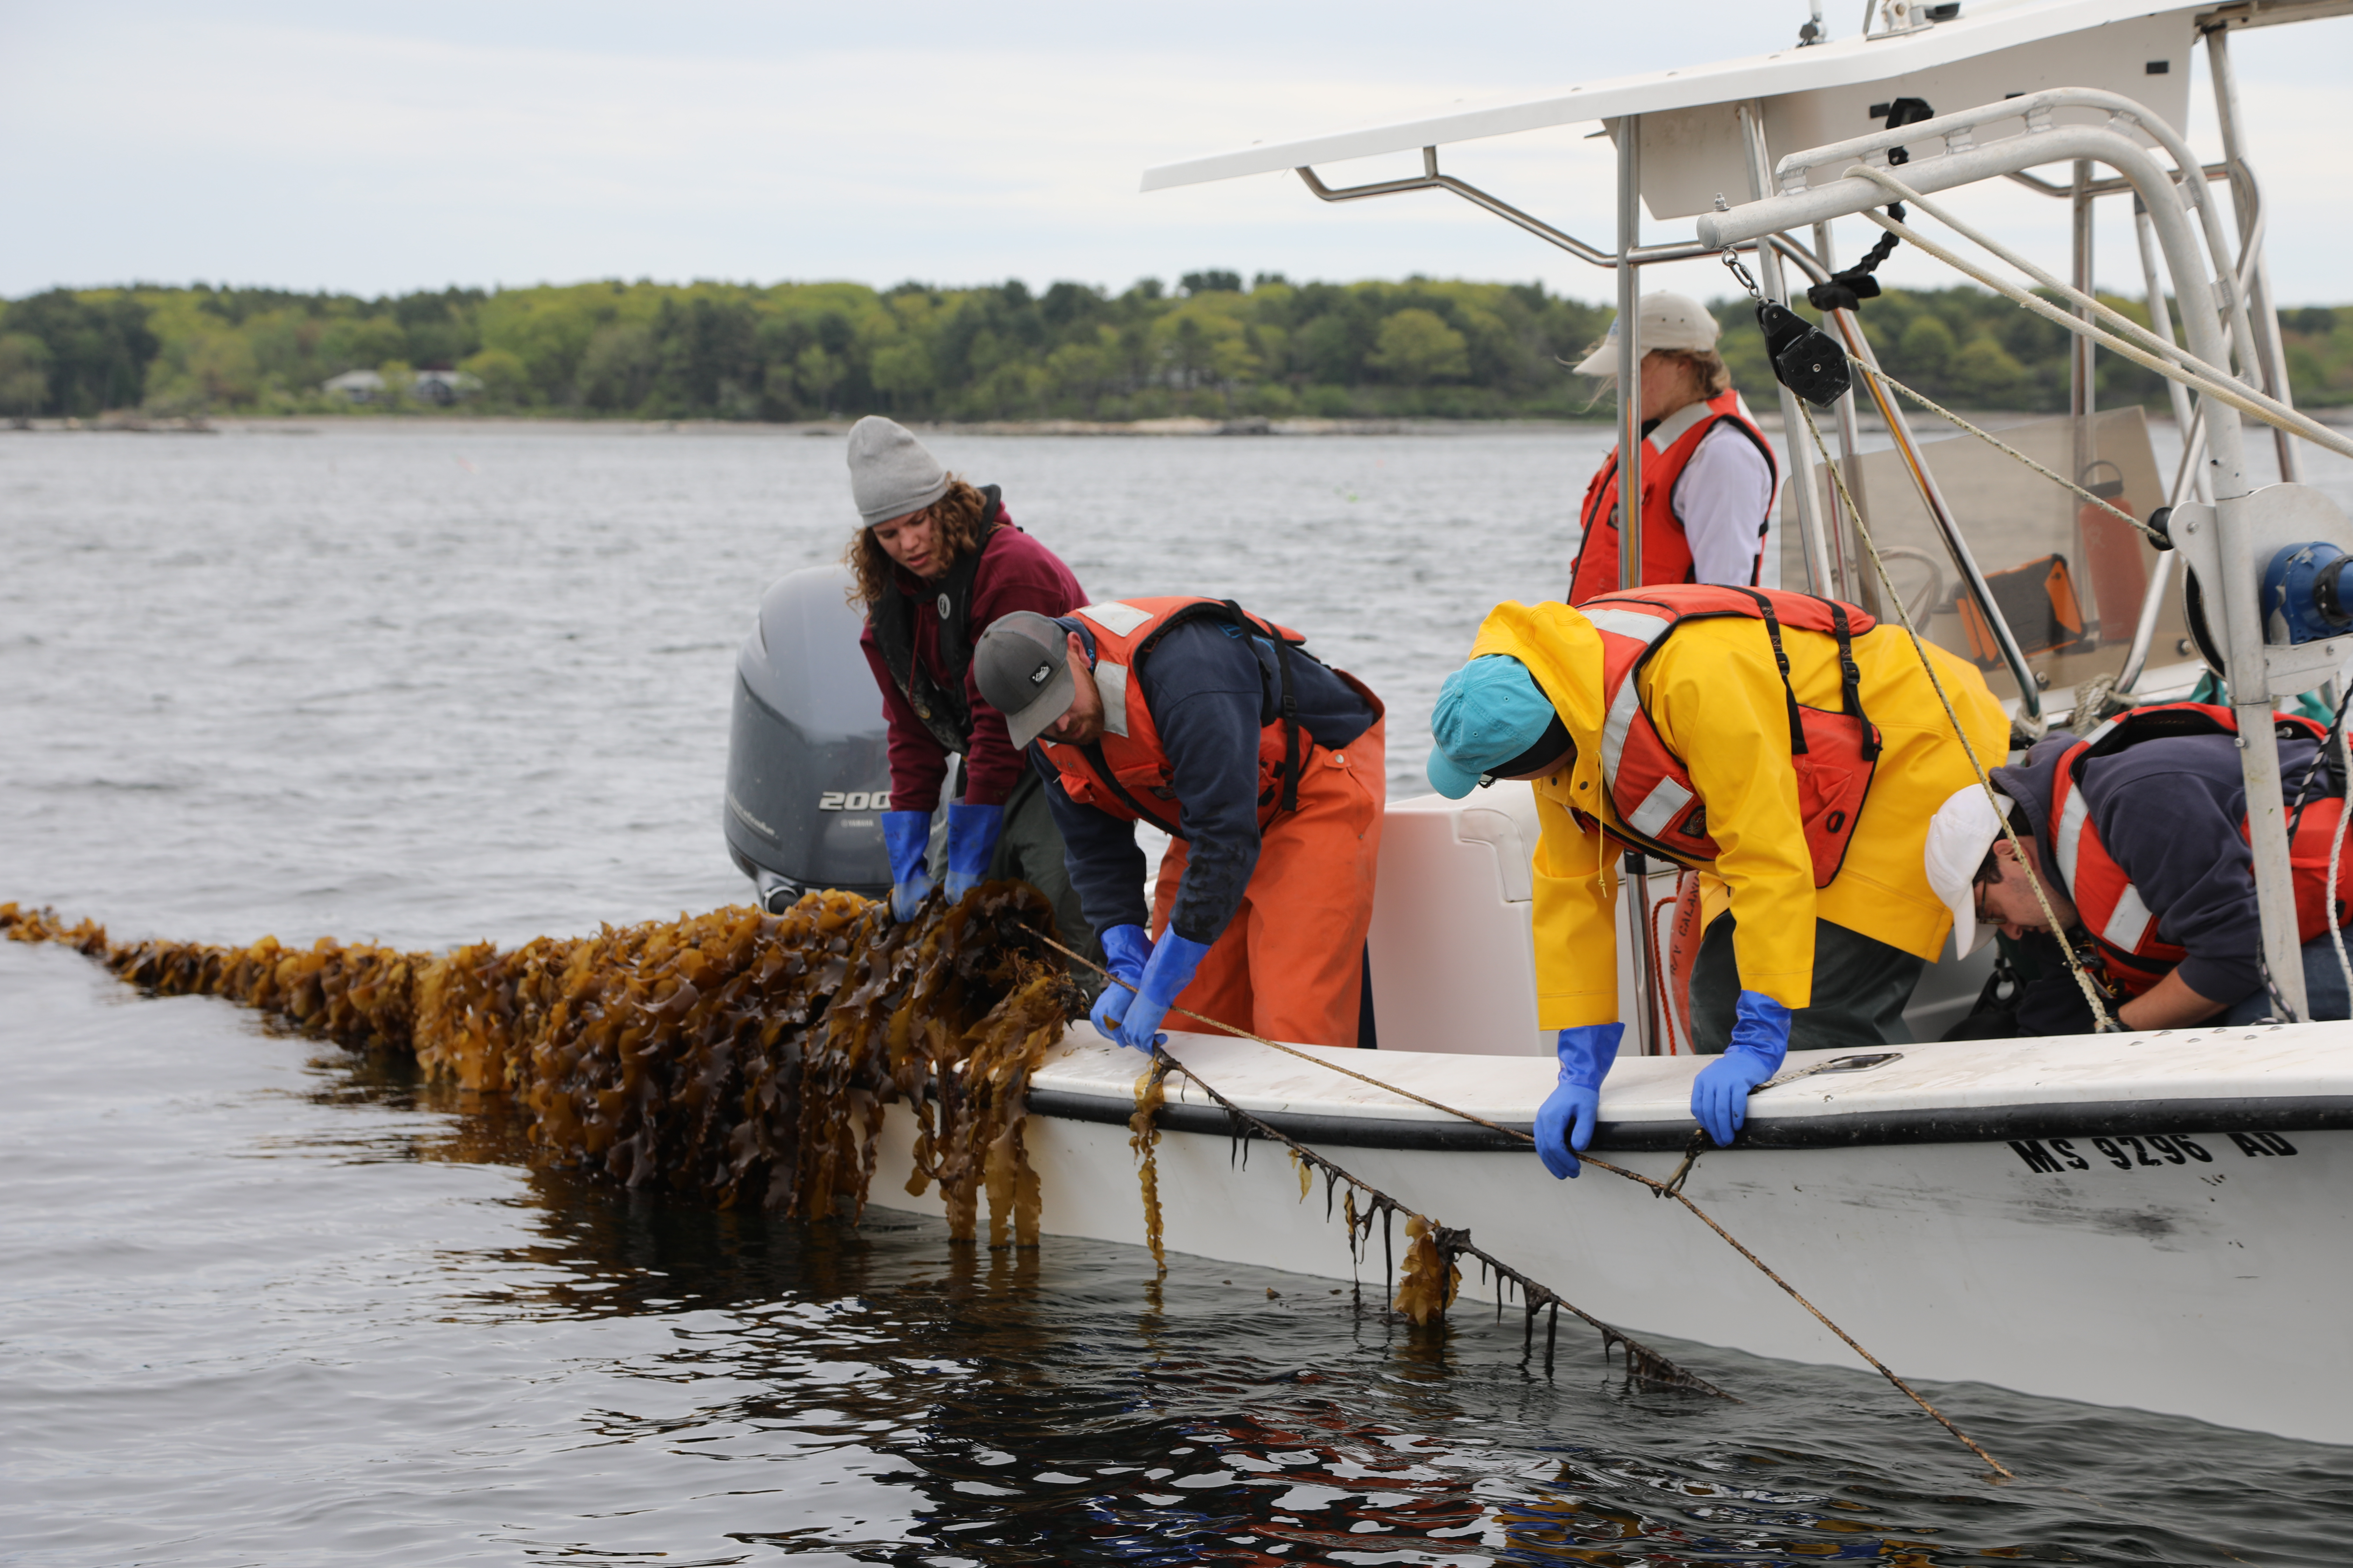

F x M

Slide 6
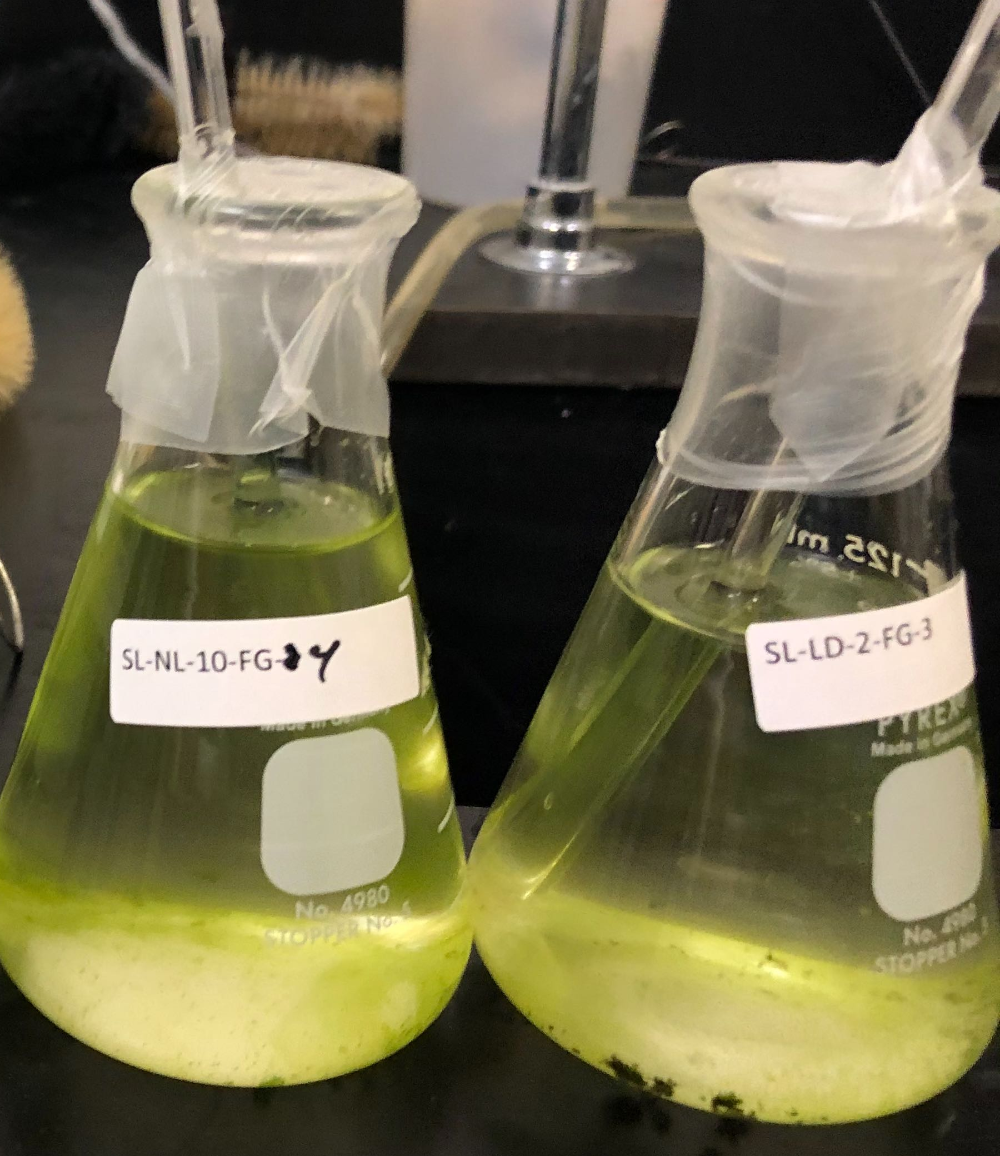
A few Obstacles
1. Gametophytes (GPs) from harvested Sporophytes (SPs) did not accumulate enough biomass to cross in the same calendar year → one year delay
2. Labor intensive to maintain the GPs cultures in the lab → the number of SPs can be made and tested is limited
3. Top ranked SPs did not go through a reproductive phase or their GPs being contaminated → random selection rather than selecting the best SPs

Slide 7
Simulation to “overcome” obstacles
Tested 3 schemes
Scheme 1
Use GPs every 1 year VS every 2 years
Scheme 2
Test more SPs in the garden (1000 VS 400)
Scheme 3
Use best SPs (Phenotypic selecting Top VS Random)
Compare Changing trends for genetic mean and variance at each stage

Slide 8
Schemes
1 Year/Cycle
GP
SP
Founder
GP
SP
SP
GP
SP
SP
SP
2 Years/Cycle
Founder
GP
GP
GP
GP
SP
SP
Select SP
Top vs Random
Phenotyping SP
1000 vs 400
Number of GPs
96 vs 24
Notes:
The first two years, draw SPs from founder population
From the 3rd year on, test three different schemes
100 reps
Estimate the genetic mean and genetic variance at the SPs stage

Slide 9
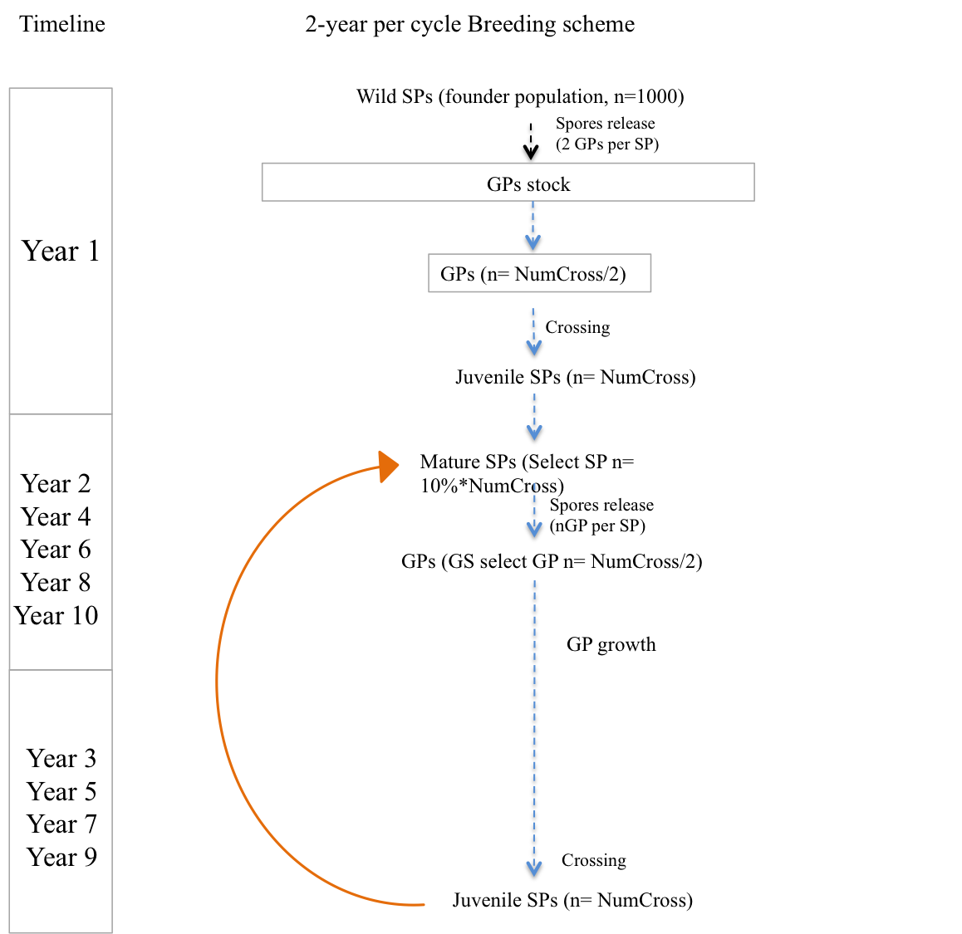
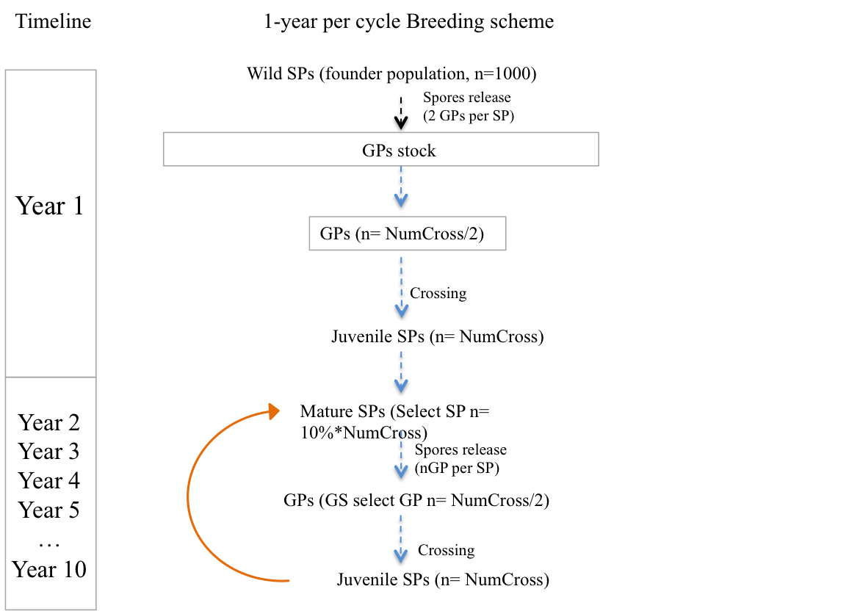
Breeding schemes comparison

Slide 10
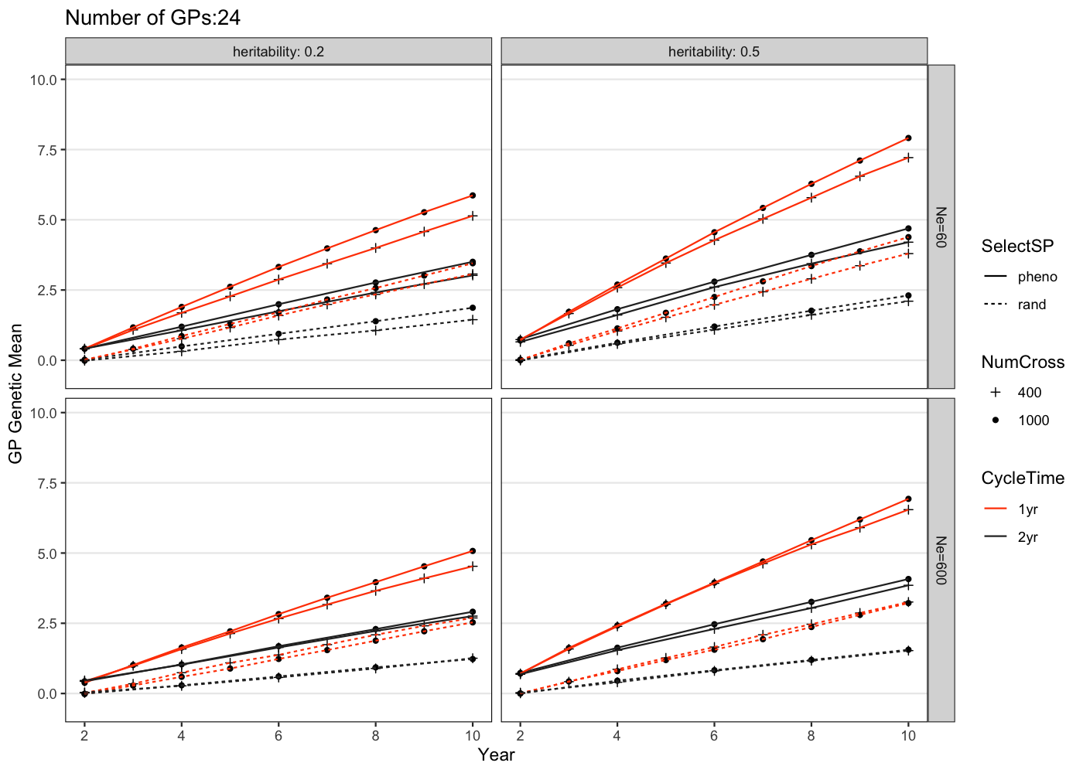
Changes of genetic gain over generations
-- Exerting selection on SPs phenotypically > randomly
-- 1-year cycle > 2-years cycle
-- Phenotyping more SPs plots (NumCross) did not give significantly higher gain than phenotyping less plots

Slide 11
Breeding practices to be prioritized based on simulation results
Improve our ability to induce SP spore release
Allow for obtaining GPs from phenotypically selected SPs
Modify GP culture process to accelerate growth; Experiment with the amount of GP biomass needed to make crosses and the SP plot sizes
Allow for faster breeding cycle

Slide 12
AlphaSimR Steps
I. Simulate Founder haplotypes
II. Set up global simulation parameters and get diploid Founders
III. Simulate your breeding pipeline
IV. Evaluate simulation results

Slide 13
I. Simulate Founder Haplotypes
Founder haplotypes
forms the genome of your simulation species in the very beginning
Progeny genotypes
Derived from these haplotypes using simulated mating, mutation and genetic recombination.

Slide 14
I. Simulate Founder Haplotypes
runMacs2() function inside AlphaSimR
Markov Coalescent Simulator
Model based methods to simulate DNA sequences
It assumes sites near each other will have recombination, but far away ones are independent.
It models recombination events and mutation, which are assigned to follows a Poisson process along the sequence length.
Notes:
; It starts from left side to the right

Slide 15
II. Set up Global Simulation Parameters
Some can be estimated from empirical data
H² → define the varE, given varG=1
LD → estimate founder effective population size
Some will be based on your breeding experience or from literature
Number of individuals to start with
Number of Chromosomes
Number of segregating sites per Chromosome
Number of QTLs per Chromosome for simulated trait
Etc
These parameters will then link genotypic variation to phenotypic variation

Slide 16
III. Set up your breeding pipeline
Sketch out Breeding pipeline
Be familiar with AlphaSimR basic functions
IV. Evaluate simulation Results

Slide 17
AlphaSimR example functions
Go to R markdown

Slide 19
Class II Simulating a whole Breeding Pipeline
Need to prepare for
Detailed Breeding pipeline information
Crossing or Selfing
How many progenies to generate in each step
How many to phenotypic and/or to genotype
Programing skills
We will use Sneller Wheat breeding pipeline as a demo example
Compare genetic gain using all PS vs GS at the yield testing stage

Slide 20
Sneller Wheat breeding pipeline (modified for demo simplicity)
Pool of Parents
P1 x P2
F1
F1:2 heads
F1:2 HR
F3
F4
F4:5 heads
F4:5 HR
YR1
YR2
YR3
YR4
20
75 pair; each make 3 times =225
225
225
225
200
120
115*120=13800
115*120=13800
1000
450
100
25
Random selection
Selection Criteria:
Phenotypes
VS
GEBVs

Slide 21
Example script
Go to R markdown

Slide 23
Additional Tools

Slide 24
Optimal Contribution Selection
Optimal contribution selection
maximizes the mean breeding value in next generation population+ its average kinship does not exceed upper bond threshold.
Maintain diversity, reduce rate of inbreeding
This constraint is measured by effective population size (Ne)
Δf<= 1/(2*Ne)
optiSel package
Upper bond for mean kinship in the population:
ub.fPED<- mean_relationship+(1-mean_relationship)*Δf
Wellmann et al. 2021
Notes:
Limit the speed of inbreeding

Slide 25
Example: Sugar Kelp
GPs with high GEBV may have small contribution to population diversity
OC
Select Top 50
GPs GEBV for Dry Weight per Meter

